Slide 1
Unit 1.2: Conceptual foundations
Gender and climate change in agriculture
Gender in Adaptation Planning for the Agriculture Sectors
Training Workshop
[Name of presenter]
[Date]
Notes:
Note to trainer: See Unit 1.2 in the Guide for Trainers for ideas for ideas on introducing key concepts and issues related to gender equality in adaptation planning for the agriculture sectors.

Slide 2
Learning outcomes
Explain
Explain basic climate change and gender concepts.
Identify
Identify at least 3 ways climate change may affect women/men who depend on agriculture sectors for food security, livelihoods, wellbeing.
Identify
Identify at least 3 reasons why gender is important to consider in adaptation planning for agriculture sectors.
Name
Name global and national climate change and gender policy commitments.
Identify
Identify 1-2 initiatives/organizations, that can coordinate to work on gender, adaptation, agriculture.

Slide 3
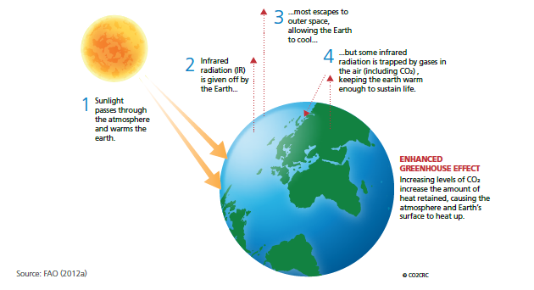
Part 1: Climate change in agriculture
Climate variability refers to natural climate fluctuations.
With climate change, there is increased variability and unpredictability of weather and climate events and subsequent impacts on food security, rural livelihoods, and overall well-being.
The Enhanced Greenhouse Effect
Notes:
Note to trainer: Invite a local expert to present the basics of climate change in agriculture in the local context.
Training participants may also be able to provide definitions.

Slide 4
Responses to climate change
Adaptation
Mitigation
aimed at reducing the vulnerability of natural and human systems against actual or expected climate change effects.
various types, e.g. anticipatory and reactive, private and public, and autonomous and planned.
examples include raising river or coastal dikes, the substitution of more temperature shock resistant plants for sensitive ones, etc.
addresses the cause of climate change including technological change and substitution that reduces and/or removes net greenhouse gas emissions or emissions per unit of output.
implementing policies to reduce greenhouse gas emissions in the atmosphere and enhance sinks.
Climate-smart agriculture
integrates the three dimensions of sustainable development (economic, social and environmental) by jointly addressing food security and climate challenges.
composed of three main pillars: (1) sustainably increasing agricultural productivity and incomes; (2) adapting and building resilience to climate change; and (3) reducing and/or removing greenhouse gas emissions, where possible

Slide 5
Why climate change adaptation in agriculture?
Agriculture sectors highly affected by climate change.
Agriculture sectors = primary contributor to total economic output, employment in many countries.
Nearly 80 % of world’s poor live in rural areas. Most depend on agriculture for livelihoods.
CC adaptation in agriculture sectors among priorities in many national climate plans.
Adaptation planning for agriculture sectors must be targeted, context-specific to be effective.
Notes:
Note to trainer: Update the content of this slide with facts and figures on thr national context.

Slide 6
What can climate change adaptation do for agriculture?
Adaptation can increase range of ways in which farmers and ecosystems can cope.
Adaptation strategies in agriculture based on combination of actions & systemic changes.
Time span of adaptation options can vary considerably.

Slide 7
Part 2: What is gender and why is it important to adaptation in agriculture?
Gender refers to socially constructed roles, relations, behaviours, and expectations of women, men, boys and girls.
Unequal access and inequitable decision-making power contribute to the persistence of a gender gap in agricultural productivity
Notes:
Note to trainer: You may want to have a local gender specialist expand on the definition of gender with local examples as well as relevant national policies on following slides

Slide 8
Why is gender important to adaptation in agriculture?
CC can impact different people differently; exacerbate gender, age inequalities in agriculture.
Adaptation options depend on institutional and behavioural changes built on analysis.
Men/women may be differently vulnerable to CC impacts (age, socio-economic strata, ethnicity, caste, etc.).
Institutions that shape adaptation responses may reinforce existing inequalities.
More equal HH, community gender relations = better agricultural, development outcomes.
Addressing gender issues can improve adaptation policymaking and programming.

Slide 9
Global gender commitments
Paris Agreement
Nationally Determined Contributions (NDCs)
Lima Programme of Work
UNFCCC Gender Action Plan
Other, e.g. Agenda 2030/Sustainable Development Goals
Example:
Nepal = signatory to 23 human rights treaties, international human rights instruments that support GE, e.g. CEDAW, Beijing Platform for Action (BPfA), SDGs, UN Security Council Resolutions 1325 and 1820, etc.

Slide 10
National gender commitments
Most countries have gender policies, strategies.
Adaptation planning should align with CC and Ag. policies and plans including those that mainstream gender and those focused specifically on gender.
Legislation around inheritance, land title, resource use relevant to adaptation
Examples:
Uganda’s National Climate Change Policy mainstreams gender and human rights.
Vietnam’s National Climate Change Strategy makes gender a priority.
Notes:
Note to trainer: Update with local policies

