Slide 1
Unit 2.1: Gender-responsive approach to planning
Gender in Adaptation Planning for the Agriculture Sectors
Training Workshop
[Name of presenter]
[Date]
Notes:
Note to trainer: See Unit 2.1 in the Guide for Trainers for ideas for a session on the concepts related to mainstreaming gender in the adaptation planning process.

Slide 2
Learning outcomes
Define
Define some of the key elements of good governance and why it is important in the context of gender-responsive adaptation planning.
Explain
Explain what is meant by gender-responsive adaptation.
List
List examples of actions that can be taken to mainstream gender into an adaptation plan.
Identify
Identify the roles of different stakeholders in supporting a gender-responsive approach to adaptation planning in the agriculture sectors.

Slide 3
Principles of good governance
Participation
Empowerment
Responsiveness
Consensus-oriented
Inclusiveness
Equality
Non-discrimination
Transparency
Accountability
Process of communication, having a role in decisions
Process leading to greater awareness, participation, decision-making power and control
Institutions have full knowledge of, and respond to, the needs and priorities of target groups
Consider different viewpoints to reach broad-based agreement on how to proceed in best interests of women and men
Involve a selection of people from key stakeholder organizations
Policy measures address structural inequalities, including gender inequality
Making sure that a plan or policy does not reinforce any discriminatory practices by benefiting certain groups at the expense of others
Ensuring decisions are made and actions implemented in accordance with rules, norms and regulations that are known and understood by all whom they affect
Individuals and organizations have an obligation to explain and justify decisions and actions to those affected

Slide 4
Gender-responsive adaptation
Adaptation practices, projects or plans that contribute to gender equality through:
Recognition of gender differences in adaptation needs, opportunities and capacities
Equitable participation and influence by women and men in adaptation decision-making processes
Equitable access to financial resources and other benefits resulting from investments in adaptation between women and men
Source: NAP Global Network. 2017. “A Framework for Gender-Responsive National Adaptation Plan (NAP) Processes”
Notes:
Note to trainer: This slide introduces a key concept that is used throughout the course (e.g. again in unit 4.1).

Slide 5
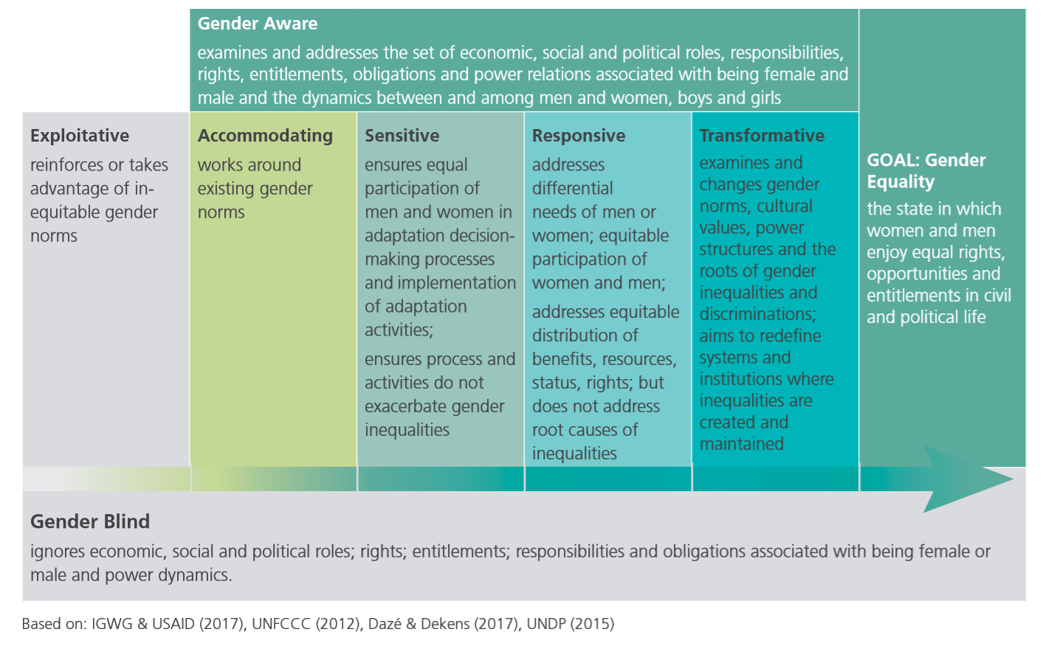
Approaches to addressing gender:
The gender integration continuum
Notes:
Note to trainer: Explain that “gender-responsive” falls on a continuum of approaches to addressing gender. You can direct participants to Figure 2.1.2 and the related text for full descriptions.

Slide 6
Integrating/mainstreaming gender in adaptation planning
Definition:
  Assess the implications for women and men of any planned action, including legislation and policies.
  A strategy for achieving gender equality and improved adaptation outcomes by overcoming marginalization of under-represented groups within

Slide 7
Integrating gender in adaptation planning requires different skills and actions
Addressing attitudes and improving knowledge
Clarifying values and attitudes around the importance of addressing gender issues in climate change adaptation
(Unit 1.2)
Ensuring a gender-responsive planning process
Promoting principles of good governance
(Unit 2.1)
Analysing the problem and solutions
Conducting a gender analysis in the agriculture sector to inform the adaptation plan
(Unit 3.1)
Formulating the plan and gender-responsive budgeting
Monitoring and managing for change
Improving understanding of basic concepts for integrating gender in agricultural adaptation
(Unit 1.2)
Conducting inclusive stakeholder consultation and stocktaking to identify gender-responsive adaptation initiatives and gaps
(Unit 2.2)
Assessing gender dimensions of climate vulnerability
(Unit 3.2)
Formulating an adaptation plan document to address gender issues
(Unit 4.1)
Allocating resources of an adaptation plan using gender-responsive budgeting
(Unit 4.2)
Monitoring the implementation of the plan using gender indicators
(Unit 5.1)
Improving gender capacity at all levels plus meeting goals
(Unit 5.2)
Prioritizing gender-responsive adaptation options
(Unit 3.3)
Notes:
Note to trainer: This slide indicates where in the training different skills and actions are covered. It is used again in Unit 5.2 to help summarize what has been covered in the workshop and to help in setting goals.
You can introduce it here as an overview of the skills needed to mainstream gender into adaptation planning and to clarify what skills will be covered in the training.

Slide 8
Roles in mainstreaming gender
Everyone involved in adaptation planning for the agriculture sectors has a role in addressing gender
What are some actions different actors could take to mainstream gender into adaptation planning?
Notes:
Note to trainer: Ask participants to give examples of some actions different actors can take in mainstreaming gender, e.g. Ministry of Gender can provide guidelines and trainings, academics can provide gender analysis, NGOs can represent views of rural groups, etc.

Slide 9
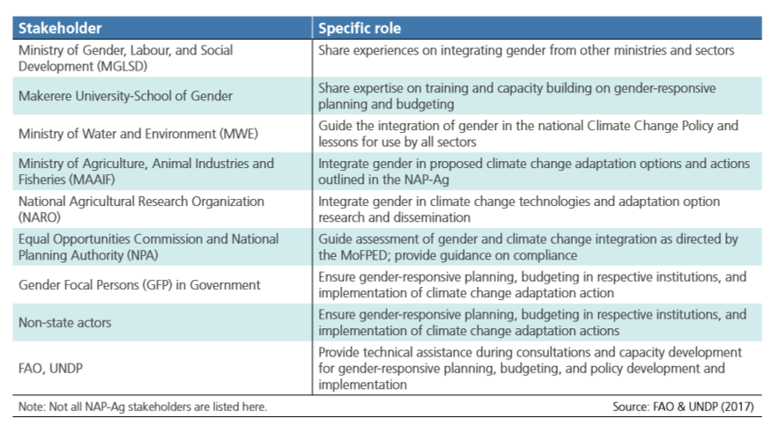
Example
Stakeholders’ roles in addressing gender in the process of developing a NAP for the agriculture sectors, Uganda
Notes:
See Table 2.1.1

