Slide 1
Unit 3.2: Gender in climate vulnerability and risk assessments
Gender in Adaptation Planning for the Agriculture Sectors
Training Workshop
[Name of presenter]
[Date]
Notes:
Note to trainer: See Unit 3.2 in the Guide for Trainers for ideas for a session on designing and conducting vulnerability and risk assessments using a gender perspective to give adaptation planners a more accurate picture of the kinds of resiliencies and vulnerabilities that men and women experience in the agriculture sectors.

Slide 2
Learning outcomes
Understand
Understand the concept of risk and vulnerability in the agriculture sectors from a gender perspective.
Discuss
Discuss ways to ensure that gender considerations are included in a climate vulnerability and risk assessment in the adaptation planning context.

Slide 3
Climate vulnerabilities and capacities
Women and men might be differently vulnerable to the effects of climate change.
Gender, age, ethnicity, socio-economic status, and other factors determine the different capacities people may have to adopt adaptation options.

Slide 4
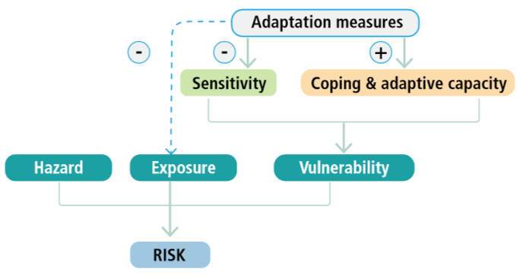
Gender considerations and components of risk
Adapted from GIZ (2016)
Notes:
Note to trainer: Explain the gender considerations of each of the terms in this graphic (Figure 3.2.1) drawing on the key messages in the Guide for Trainers. Ask participants to give examples or their own interpretations.

Slide 5
Gender-responsive vulnerability and risk assessment
An analysis of climate vulnerability and risk that women and men experience in households, livelihoods, communities, infrastructures.
Can be conducted at national, regional, community or household levels.
Uses analytical framework to inform collection, analysis of vulnerability/risk assessment data.

Slide 6
Example
Excerpt of a capacity and vulnerability assessment framework, exploring three categories of
vulnerabilities and capacities to hazard in Nepal.
 | Vulnerabilities | Capacities
Physical/material The productive resources, skills and hazards that exist | More time required for women to collect water | Switch to other crops
Social/organizational Relationships between people and their organizational structures | Limited land rights for women compared to men | Women user groups
Motivational/attitudinal How the community views its ability to create change | Limited time for education | Social networks
Notes:
Note to trainer: You may refer participants to Box 3.2.1 and Table 3.2.1 for more detail.

