Slide 1

Country Name
Presenter Name
ZAMBIA
Mukufute M. Mukelabai

Slide 2
Introduction
  Progress and Key Successes
  Concerns, Challenges, Opportunities
  Last Mile

Slide 3
Meteorological Monitoring Equipment and Systems
28 Automatic Weather Stations – ordered and delivered to Zambia Meteorological Department
Installation of the AWSs is under way – expected to be completed by end of April 2016
New instruments for 39 manual weather stations – Ordered and awaiting delivery

Slide 4
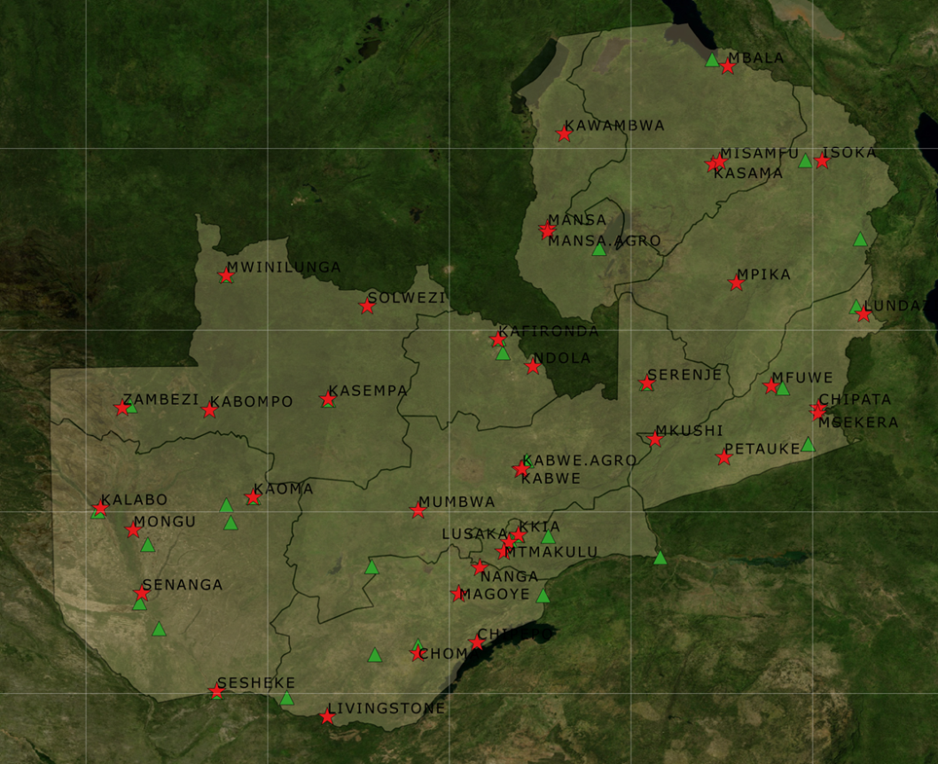
Current Observation Station Network
39 Manual Stations
38 Installed AWS
28 AWS currently being installed
Over 50 years of Time-Series data for a Typical Manual Station
Up to 5 years of AWS Data

Slide 5
Training
Type of training | 2015 | 2016 | Total students | Comment
Bachelor of Science Climatology | 3 | 3 | 6 | 1st graduates in 2018
Diploma Meteorology | 12 |  | 12 | 1st Graduates in December 2017
Diploma electronics |  | 4 | 4 | Graduating in December 2018
Total | 15 | 7 | 22

Slide 6
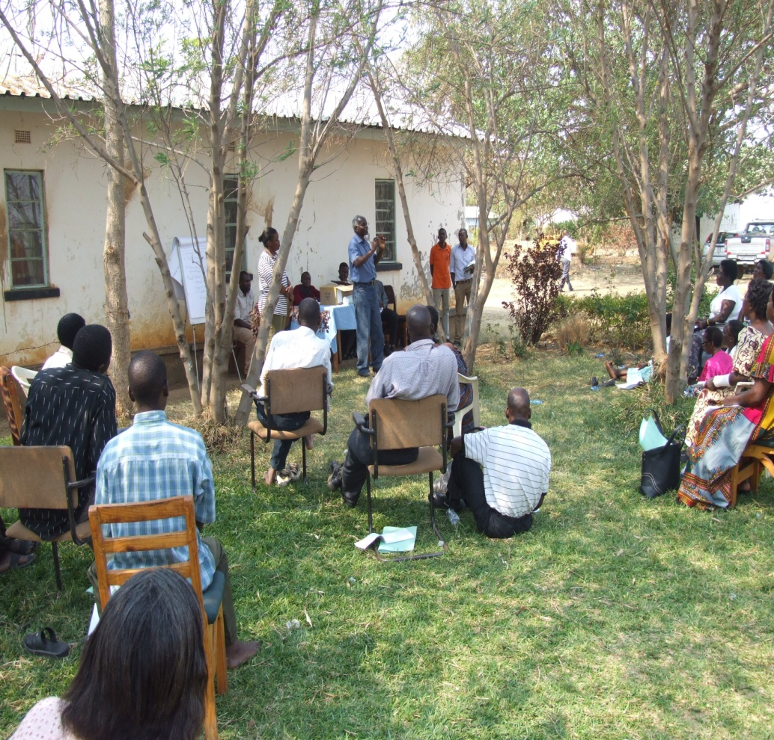
Communication
Climate Outlook Forums conducted in Lusaka, Mambwe, Gwembe and Sesheke.
Communications consultant hired to:
  develop a CIEWS communications strategy and action plan
  conduct training for meteorological officers in community engagement
  develop CIEWS brochures in English, Lozi, Nyanja and Tonga
  facilitate the following meetings:
    Parliamentary briefing session
    House of Chiefs briefing session
Supporting installation of a community radio station in Sesheke district’

Slide 7
Private Sector Engagement
Meteorological Act (Bill) is expected soon and will promote private ‘Public Private Participation’ in meteorology.
Held meetings with Airtel and Zamtel in 2015 (weather information dissemination and sensor hosting on telecoms towers)
Held meetings with NICO Insurance and Madison Insurance in 2015 (weather-index insurance)

Slide 8
Study tour to Tanzania Meteorological Agency
Study tour of Tanzania Meteorological Agency (9 – 11th September 2015)
Looked at their facilities and products:
  Climate
  Agromet
  Forecasting, and
  Engineering

Slide 9
Concerns
Sustainability of the network beyond the project.
Ability of PPP to support ZMD observation network and service delivery.

Slide 10
Challenges
Making weather and climate information accessibility to rural communities.
Provision of area specific weather and climate information – currently, ZMD has gridded rainfall and temperature data.
Provision of real-time localized weather forecasts and warnings
Instrument calibration and maintenance

Slide 11
Opportunities
Enactment of the Meteorological bill: the meteorological bill when signed will enable ZMD to charge for some products and services.
Expansion of the hydro-meteorological network by the Water Resource Management Agency (WARMA) and Department of Water Affairs (DWA)

Slide 12
Progress
Strengthening and improving observation and forecasting
Improving communication,
Engagement of stakeholders and provision of tailored forecasts
Smallholder farmer receiving climate information to enhance local-specific decision making for resilient livelihood.

Slide 13
Needs of our end-users and stakeholders
Local weather and climate information- specific information to their area.
Seasonal characteristics: People want to know when the season will start; occurrence of wet and dry spells; secession of the rainfall season.
Easy access to timely weather information

Slide 14
Support required to achieve Last Mile goals
Early warning system
  Weather radar/lightning detectors network
Further capacity development
Extension of the project to support the implementation phase

Slide 15
Program of Work 2016
Output | Activity | Jan | Feb | Mar | Apr | May | Jun | Jul | Aug | Sep | Oct | Nov | Dec
Component 1: Transfer of technologies for climate and environmental monitoring infrastructure
Outcome 1: Enhanced capacity of Zambia Meteorological Department to monitor and forecast extreme weather and climate change
Output 1.1 28 Automatic Weather Stations installed in selected priority districts, and 41 existing manual and automatic monitoring stations rehabilitated. | 1.1.1 Undertake a systematic analysis of existing synoptic, climatic, rainfall and agro-meteorological stations to determine gaps in coverage and priority stations for rehabilitation.
 | 1.1.2 Install 28 AWSs in the selected priority districts including solar panels, batteries and General Packet Radio System (GPRS) modems for data transmission.
 | 1.1.3 Rehabilitate/upgrade 41 existing meteorological stations (including 2 automated weather stations and 39 manual stations) including procuring and replacing relevant sensors and data loggers for automated stations and instruments for manual stations, as required.
 | 1.1.4 Integrate new AWSs and privately-owned weather stations into the existing ZMD network and forecasting system.
Output 1.2 Weather and climate forecasting systems upgraded, including the installation of required hardware and software and integration of satellite observations. | 1.2.3 Review and install appropriate telecommunication infrastructure to establish connectivity of all weather stations with ZMD HQ
 | 1.2.4 Procure and install equipment including the hardware and software required for modern meteorological forecasting workstations at ZMD HQ.
 | 1.2.5 Develop and establish an online climate map room linked to ZMD’s official website.
 | 1.2.6 Conduct training for forecasters on MESSIR-COM to provide proxy upper air monitoring ascent measurements.

Slide 16
Output | Activity | Jan | Feb | Mar | Apr | May | Jun | Jul | Aug | Sep | Oct | Nov | Dec
Output 1.3 Capacity developed for operating and maintaining the climate observation network and related infrastructure including the training of 10 instrumentation technicians and 10 ICT technicians from within ZMD’s staff establishment to maintain and repair meteorological equipment, computer infrastructure and telecommunications network. | 1.3.3 Train 10 technicians (1 per province) to maintain and repair newly installed and existing computer infrastructure and telecommunications systems, as well as installed/rehabilitated meteorological equipment.
 | 1.3.4 Implement a training programme, in parallel with the installation and rehabilitation programmes, for site partners hosting AWSs, on basic O&M of installed equipment.
Output 1.4 Technical capacity of ZMD is strengthened to improve the production of standard and customized weather and climate forecasts and packaging meteorological data and information into suitable formats for user agencies and local community end-users. | 1.4.1 Train: i) 1 Agro-met officer and 2 Weather forecasters to BSc. Climatology degree level ii) 4 Meteorological Assistants to Diploma level in Meteorology; on state-of-the-art region-specific weather and climate forecasting. A. Continue supporting the already admitted 3 students to Mulungushi University for Climatologist B. Continue supporting the already admitted 12 students to ZASTI for Diploma in Meteorology
 | 1.4.4 Provide scholarship for an existing ZMD staff member to undertake post-graduate training in climatology (modelling) at an international research centre/university. An agreement will be signed with the selected student committing him/her to continued service at ZMD equaling at least the duration of the scholarship.
 | 1.4.5* Digitise all historical weather data for Mambwe, Gwembe and Sesheke.

Slide 17
Output | Activity | Jan | Feb | Mar | Apr | May | Jun | Jul | Aug | Sep | Oct | Nov | Dec
Outcome 2: Efficient and effective use of hydro-meteorological and environmental information for making early warnings and long-term development plans.
Output 2.1 Tailored, sector-specific weather and climate information made accessible to decision makers in government, private sector, civil society, development partners and local communities. | 2.1.1 Undertake a comprehensive identification of tailored climate information requirements of the agricultural, water, energy, infrastructure, health and other climate-sensitive sectors – including information exchange mechanisms, communication channels and dissemination mechanisms between ZMD, user agencies and end users – to establish best practices, gaps and opportunities for streamlining and collaboration on data use and sharing. User needs assessment
 | 2.1.4 Evaluate the costs and benefits of accurate, timely and accessible tailored, sector specific information, based on improved weather and climate data, and develop handbooks and policy briefs to highlight the value of enhanced meteorological services and early warning systems to policy and decision makers, civil society organizations, development partners and local communities.
 | 2.1.6 Map sub basin climate hazards in the pilot districts of Mambwe, Gwembe and Sesheke, including geospatial interpretation and ground truthing.
Output 2.2 National, provincial and district-level capacity developed for assimilating weather and climate information into existing policies, plans, programs and disaster management systems. | 2.2.1 Conduct a public awareness campaign on the National Meteorological Policy (2013) and the Meteorological Bill (2015), as part of the CIEWS Communications Plan
 | 2.2.2 Develop protocols for integrating weather and climate information into the National Development Plan and downscale these to local levels in priority districts of Mambwe, Gwembe and Sesheke.
 | 2.2.3 Develop the capacity of ZMD, DMMU, MAL, DWA/WaRMA, MoH, Central Statistical Office, Zambezi River Authority, ZESCO, media houses, Civil Society and associated line ministries, departments and agencies to integrate weather and climate information into decision-making about investments, as reflected in annual budgets and work plans.

Slide 18
Output 2.3 Communication channels and procedures for issuing warnings are enabled at a national level, and implemented at a district level through the development of mobile phone-based alert platforms in the pilot districts of Mambwe, Gwembe and Sesheke. | 2.3.1 Develop a national weather and climate information and early warning system communication and coordination strategy. This will include SOPs for disseminating weather and climate information including alerts across all levels, e.g. community-level, local-level, provincial level and national level.
 | 2.3.2 Assess, document and incorporate indigenous knowledge indicators used by communities to forecast weather and climate-related hazards in Zambia.
 | 2.3.3 Undertake field visits and stakeholder consultations in a subset of targeted users in the pilot districts of Mambwe, Gwembe and Sesheke to understand how recipients of advisories and warnings use the information for managing climate- and weather-related risks and how their decision frameworks affect the interpretation of advisories and warnings.
 | 2.3.4 Procure and install an early warning computing system, with dissemination / transmission system
 | 2.3.5 Undertake training for the user communities in Mambwe, Gwembe and Sesheke on the early warning dissemination system developed under Activity 2.3.4
Output 2.4 Public-private partnership developed for sustainable financing of the operation and maintenance of the installed meteorological observation network. | 2.4.1 Undertake a review of the private sector demand for improved climate information in Zambia. This will include, but not be limited to, the agriculture insurance sector, utility companies, energy producers and mobile network operators, building on the work of the IFC through the PPCR, to understand the climate information needs and market for weather index-based insurance.
 | 2.4.2 Establish a public-private partnership between an interested private sector entity and ZMD. This will include the establishment of SOPs and agreements to allow the private sector company to use the data generated by the meteorological observation network for the purpose of selling products.

